Slide 1
Forecasting Pesky SKUs

Slide 2





Meet our Team
Adithya U. Saachi L. Apoorva S. Shubham A. Jose S.

Slide 3
TABLE OF CONTENTS
04
01
IDENTIFYING PESKY SKUS
ABOUT THE CLIENT
05
PREDICTIVE MODELING
02
BUSINESS PROBLEM
06
BUSINESS OUTCOMES
03
DATA PREPROCESSING
07
FUTURE DIRECTIONS

Slide 4
01
ABOUT THE CLIENT

Slide 5
QUICK FACTS
1
2
3
4
Major auto parts Retailer in North America
5000+ Retail Outlets
Aftermarket auto parts for Cars, Bikes, and Trucks
rn
6 subsidiary
companies
une

Slide 6
BUSINESS PROBLEM
02

Slide 7






BUSINESS PROBLEM
Misunderstood SKUs
Improper Forecasting
Incorrect Reporting
Cycle of Effects
Mismanaged Inventory
Reduced Profits
Lost Sales

Slide 8
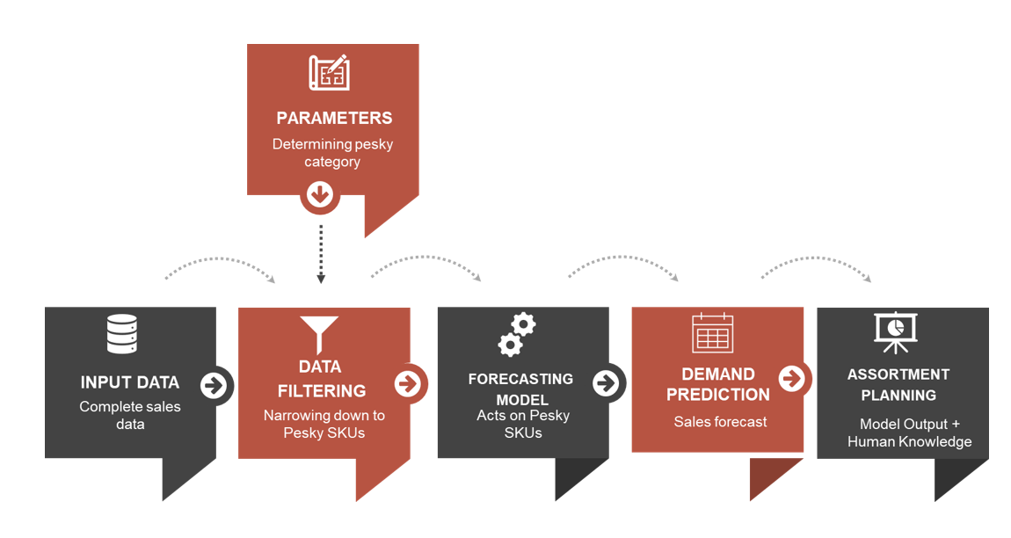
BUSINESS-TO-ANALYTICS

Slide 9
RESEARCH QUESTIONS
Problem statements
Defining and identifying pesky SKUs Are there certain splits or outlier handling techniques that should be used? What is the best way to develop an accurate forecast for “pesky” skus? Are there signals in the input variables?

Slide 10
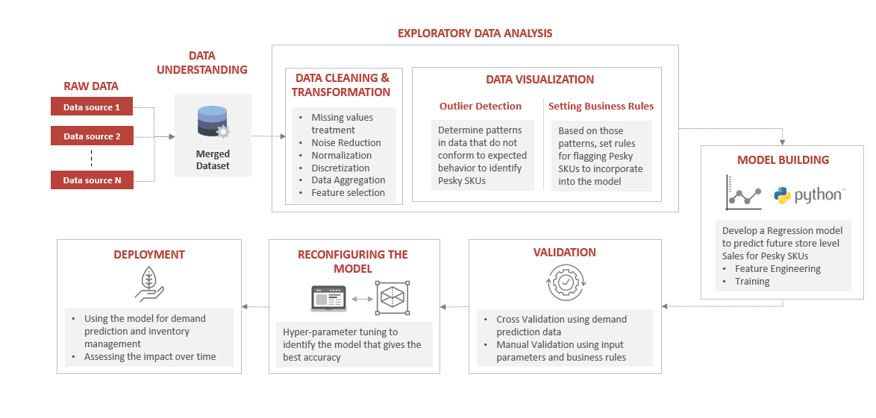
PROCESS FLOW

Slide 11

DATA PREPROCESSING
03

Slide 12





ABOUT THE DATA
Batteries
Brakes
Sales (CY & PY)
Filters

Slide 13
DATA PROCESSING FLOW
SKU Store Level Aggregation
Merging the datasets
Processing
Splitting targets and predictors
Data ready for modelling
Missing Values
Filtering
Feature Selection
Redundancy

Slide 14
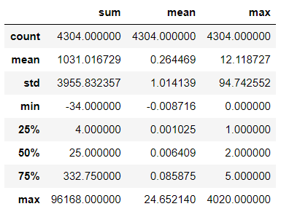
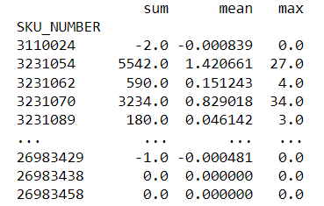
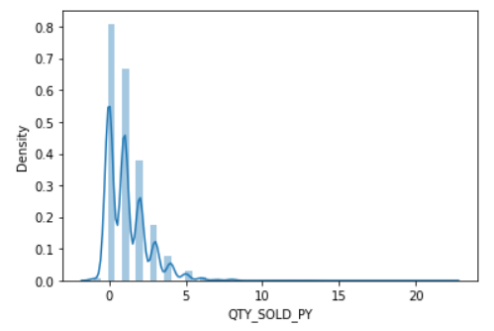
EXPLORATORY DATA ANALYSIS
SKUs with no sales
SKUs total sales Statistics
SKU's Sales per store

Slide 15
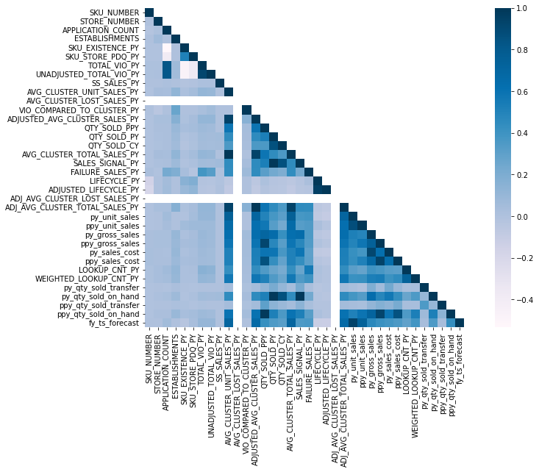
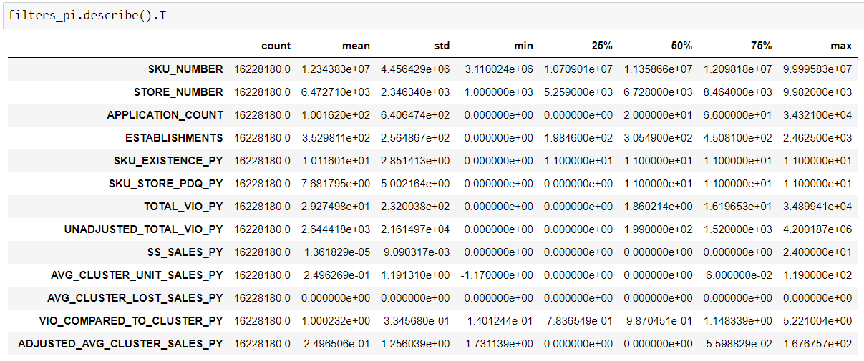
EXPLORATORY DATA ANALYSIS
Data Statistics per Variable
Analyzing Correlation

Slide 16
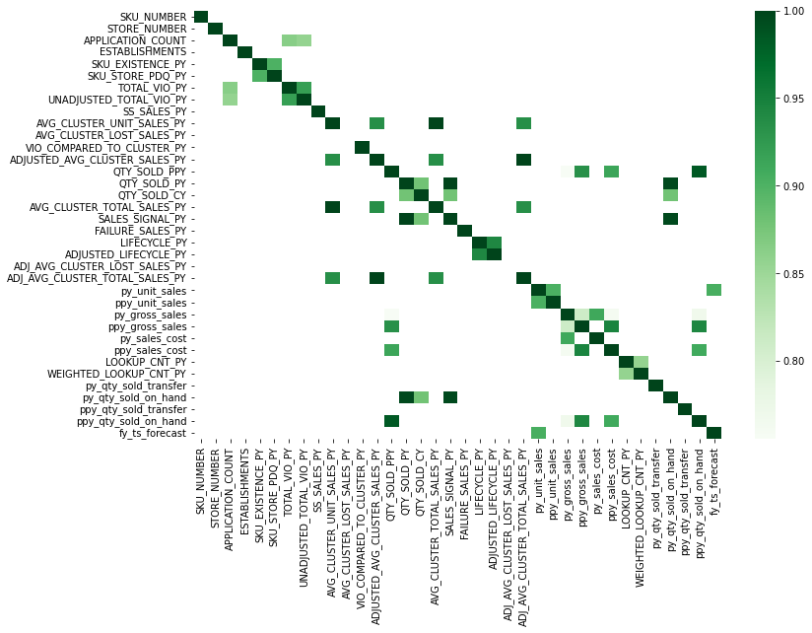
EXPLORATORY DATA ANALYSIS
Highly Correlated Variables

Slide 17
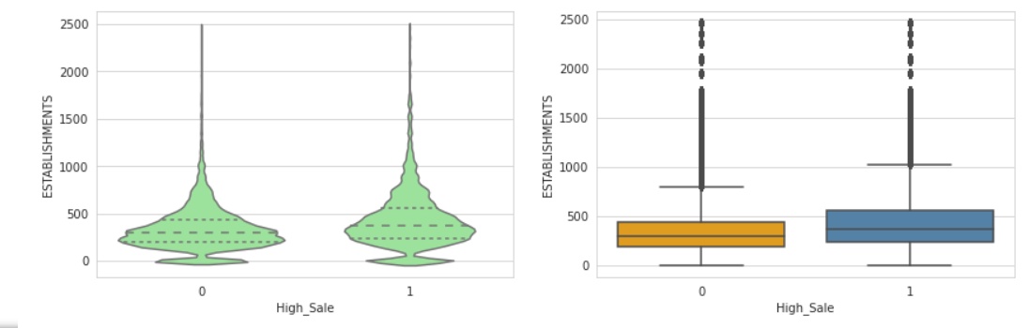
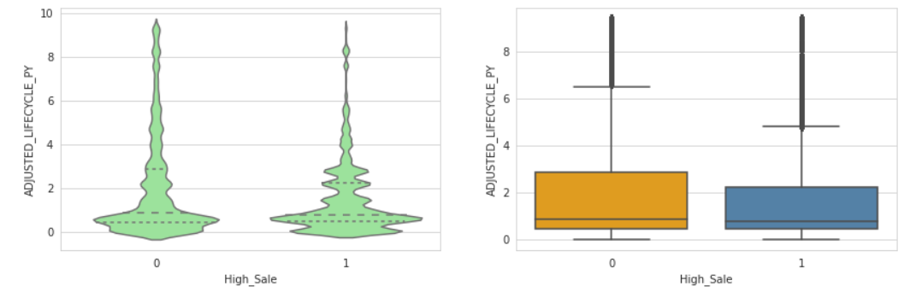
EXPLORATORY DATA ANALYSIS
Distribution across variables

Slide 18
IDENTIFYING PESKY SKUs
04

Slide 19
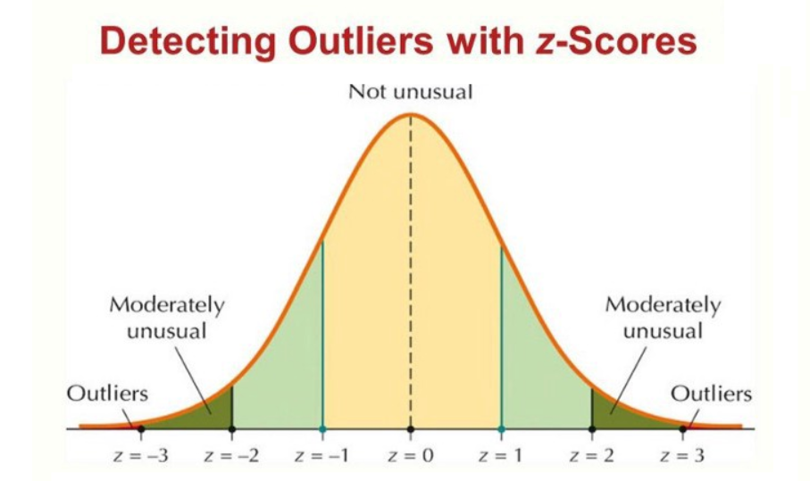
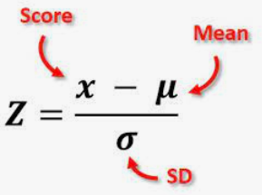
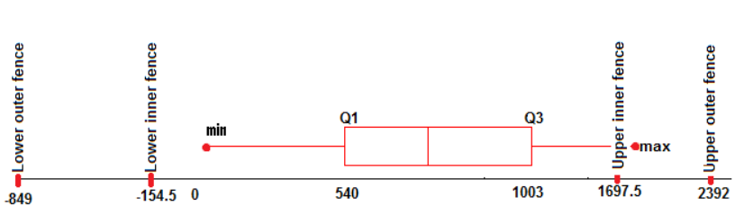
OUTLIER DETECTION TECHNIQUES
2 methods
Internally studentized residuals
(z-score method)
Tukey’s box plot method

Slide 20
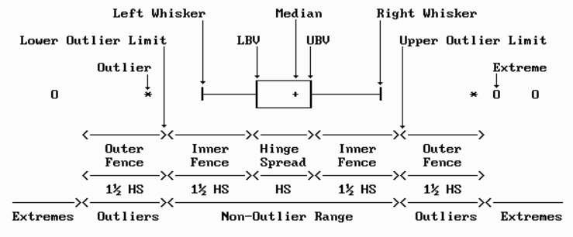
SELECTED TECHNIQUE
Tukey’s box plot method was chosen
Pesky

Slide 21
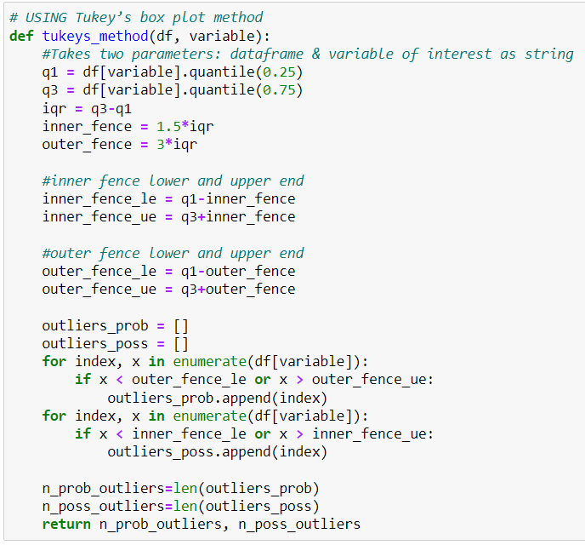
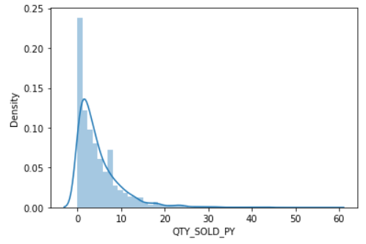
SALES DISTRIBUTION AND OUTLIER DETECTION

Slide 22

METHODOLOGY: IDENTIFYING PESKY SKUs
Tukey’s box plot method
Log-IQ extended version
Second Step
First Step
Add a small number (0.001) to sales to avoid taking log of zeros
Third Step
Fourth Step
Apply Log Transformation on sales to change the scale
Apply boxplot method to find outliers
Aggregate QTY_SOLD_PY at a SKU level

Slide 23
PREDICTIVE MODELING
05

Slide 24

MODELING PROCESS
Data
Partitioning
Set Target
Training: 60%
Validation: 20%
Testing: 20%
Fitting the Model
Training the model on 60% data
Predicting for Validation set
Predicting sales for validation set and evaluating metrics: RMSE & R-Squared
Improving Validation Metrics
Hyperparameter Tuning
Cross Validation
Feature Selection
Model Assessment
Predicting sales for holdout 20% data and checking evaluation metrics

Slide 25
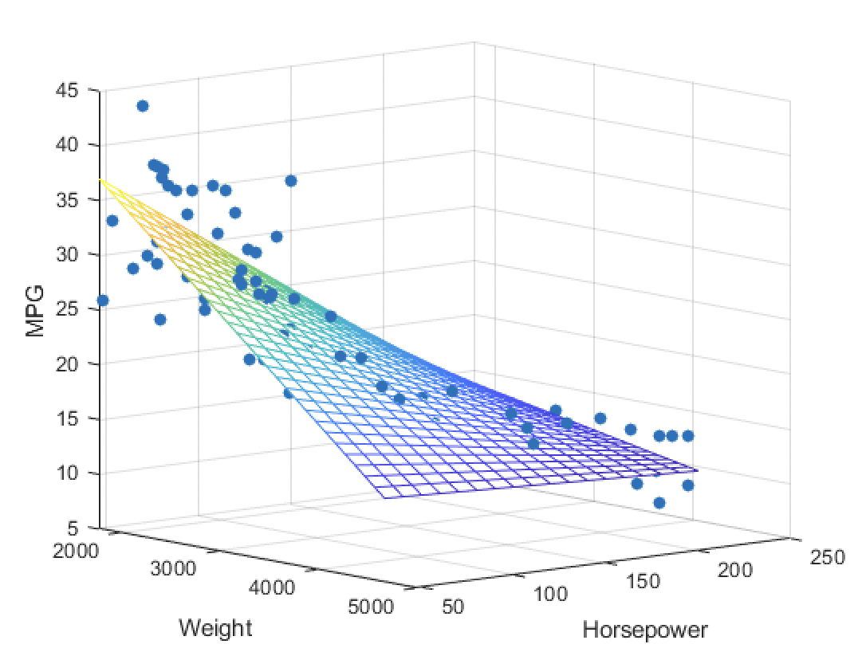
MULTIPLE LINEAR REGRESSION
Helps to understand the relationship between dependent variable and multiple independent variables
Linearity: Line of best fit through the data points is a straight line, rather than a curve
Normality: The data follows a normal distribution
More variables might lead to overfitting of model

Slide 26
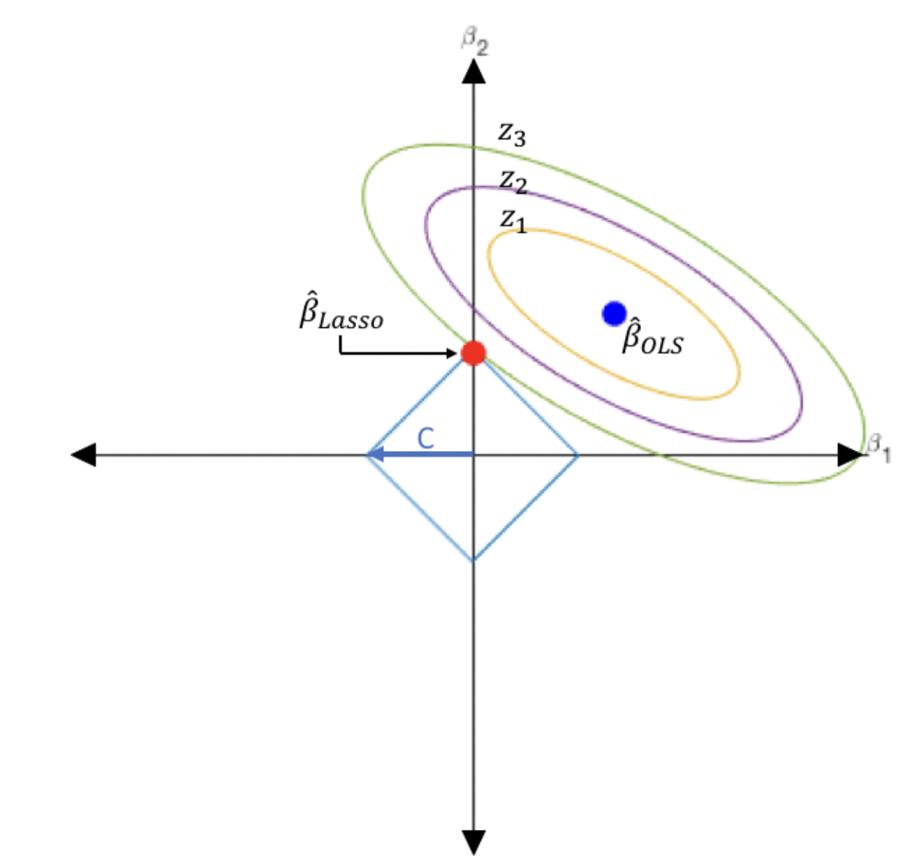
LASSO REGRESSION
Least Absolute Shrinkage and Selection Operator Regularization Technique
Uses shrinkage where data values is shrunk towards a central point like mean
Well suited for models showing high level of multicollinearity
Penalizes less important features and make their coefficients zero

Slide 27
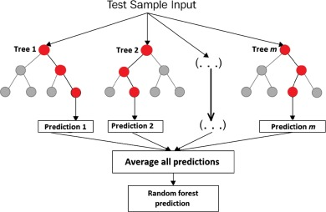
RANDOM FOREST REGRESSION
Generates a series of regression tree models
sampling, with replacement, from training data (bootstrap)
building a tree until a threshold is reached
selecting predictor variables at random for each node
average the prediction results from multiple trees
Diversity: Each tree is different and not all attributes are used. Averaging the predictions improves accuracy and reduces overfitting.

Slide 28
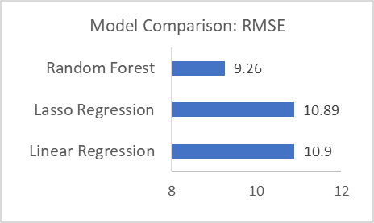
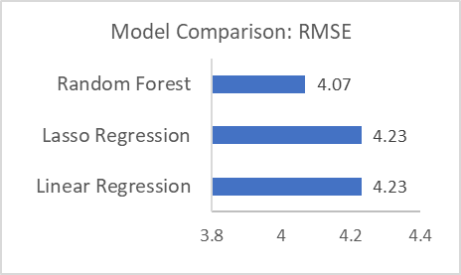
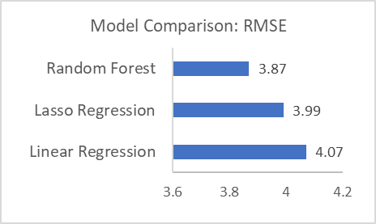
RESULTS
Batteries
Brakes
Filters
Random Forest
R-Squared: 89.27%
RMSE: 9.26
Hyperparameters
No. of trees = 110
Maximum depth = 20
Max features considered for split = 8
Random Forest
R-Squared: 79.87%
RMSE: 4.07
Hyperparameters
No. of trees = 60
Maximum depth = 15
Max features considered for split = 7
Random Forest
R-Squared: 77.45%
RMSE: 3.87
Hyperparameters
No. of trees = 150
Maximum depth = 4
Max features considered for split = Auto

Slide 29

BUSINESS OUTCOMES
06

Slide 30



BUSINESS BENEFITS
Increase Revenue
01
Improved Demand Forecasting
02
03
Better Inventory Management
Reduced Holding Costs

Slide 31
Holistic Outcomes
CLIENT
TECH
STUDENTS
Improved demand prediction and Inventory Management
Improved revenue by reduction of lost sales
Improved employee efficiency
Methodology to detect and pesky SKUs
Generalized model to predict sales for pesky SKUs
Understanding of real-world analytics project
Improved knowledge through cross-training

Slide 32
FUTURE DIRECTIONS
07

Slide 33
FUTURE DIRECTIONS
Using demographic variables such as geography could improve model accuracy
Various Product Types
Demographic Factors
Modeling for products with significantly lower or higher sales would deliver different model selection and results

Slide 34

QUESTIONS
ANY QUESTIONS?

Slide 35
THANK YOU

Slide 36
APPENDIX

Slide 37
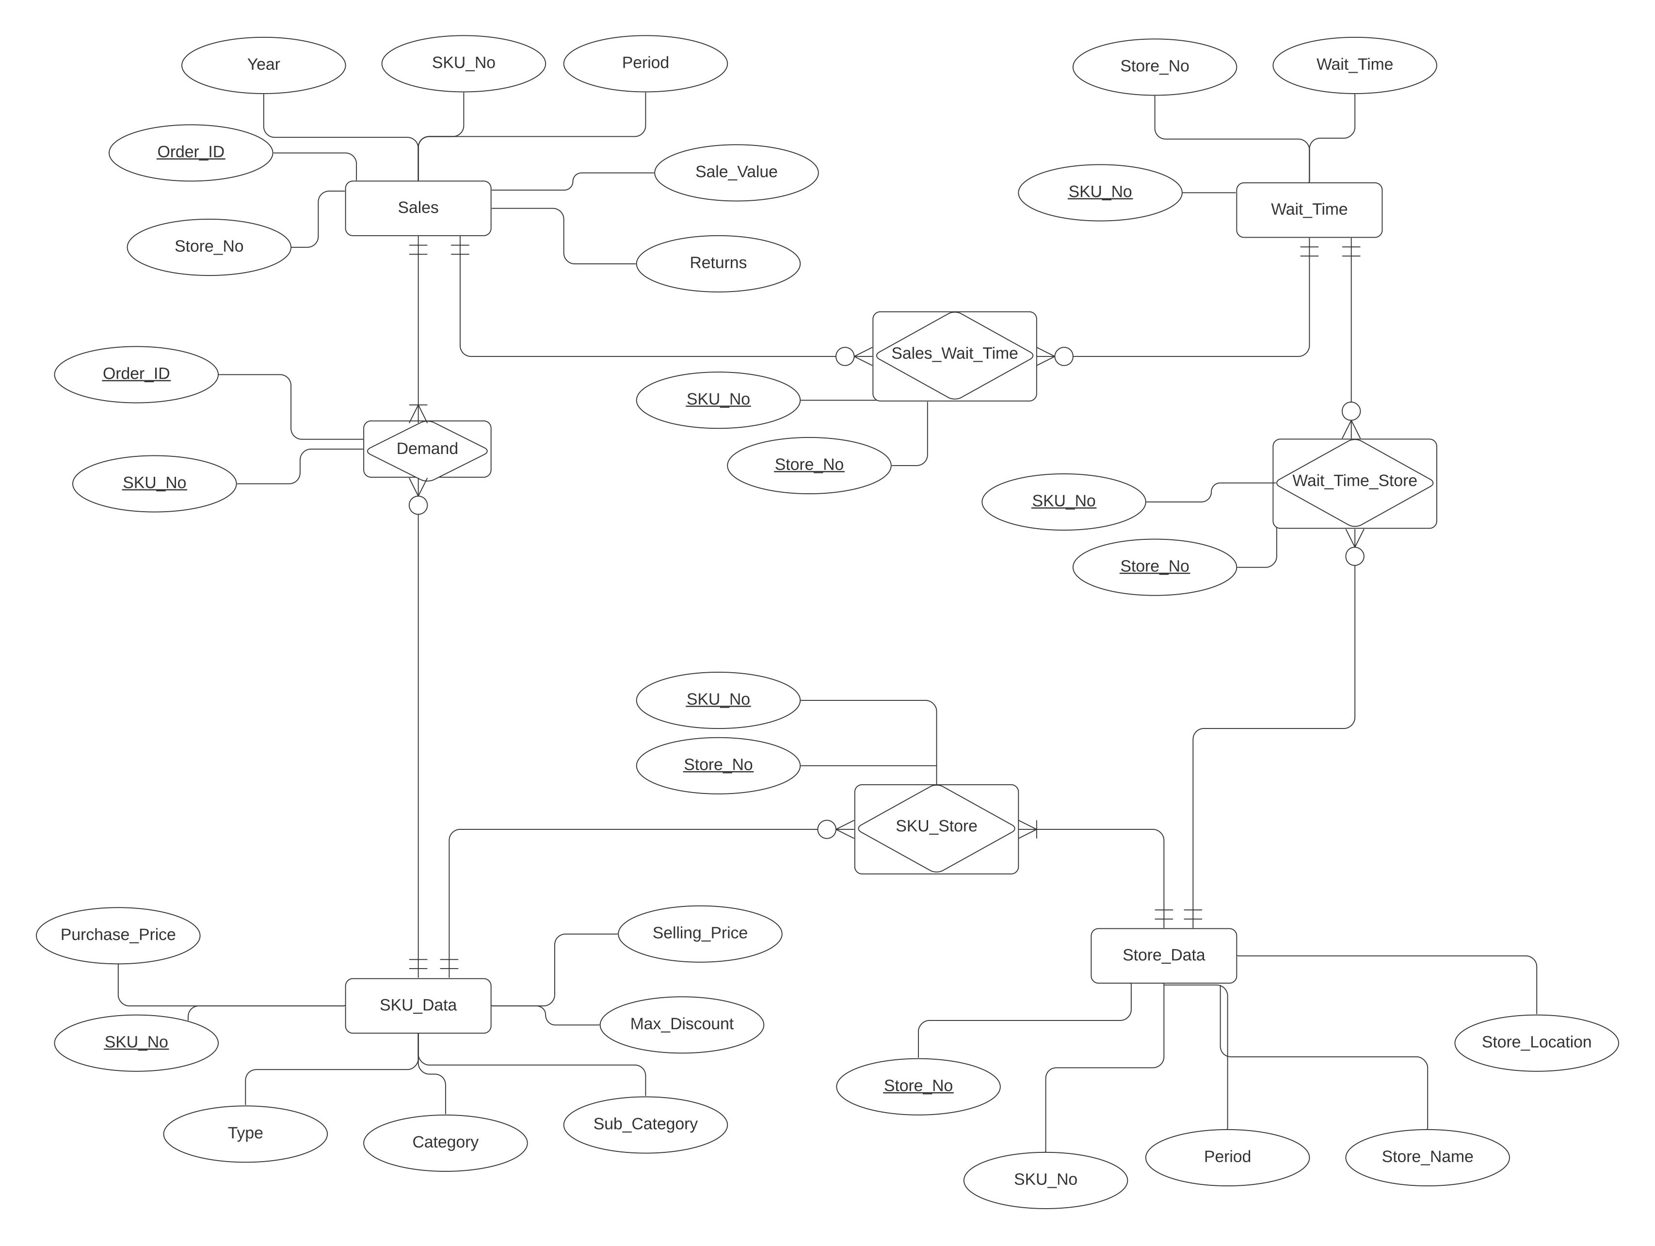
ER DIAGRAM

Slide 38
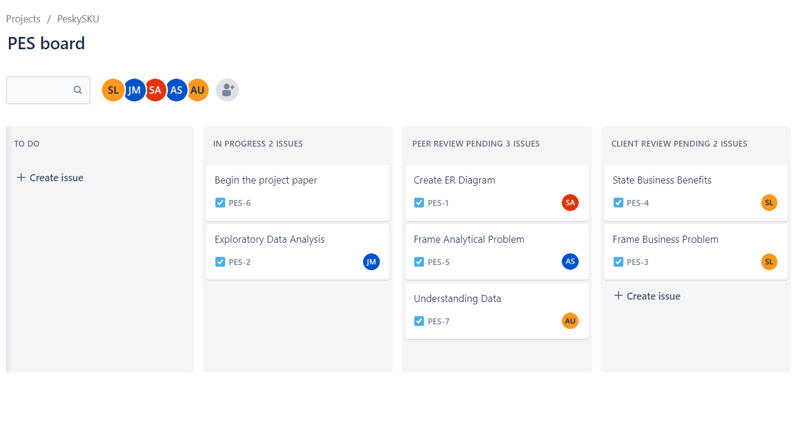
Week 1 – Tasks
Project Tracker: https://peskysku.atlassian.net/jira/software/projects/PES/boards/1

Slide 39
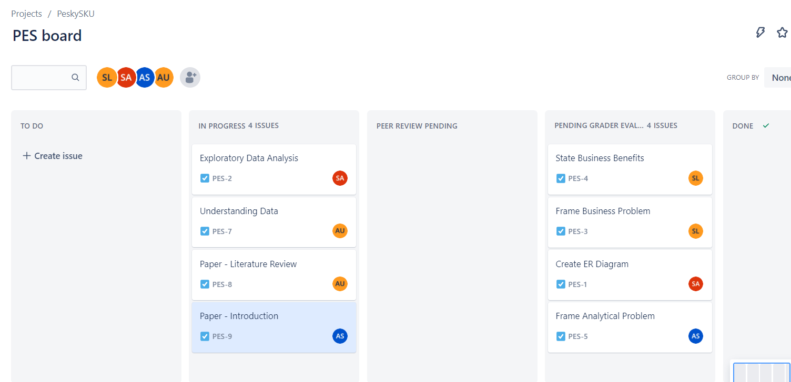
Week 2 - Tasks
Project Tracker: https://peskysku.atlassian.net/jira/software/projects/PES/boards/1

Slide 40
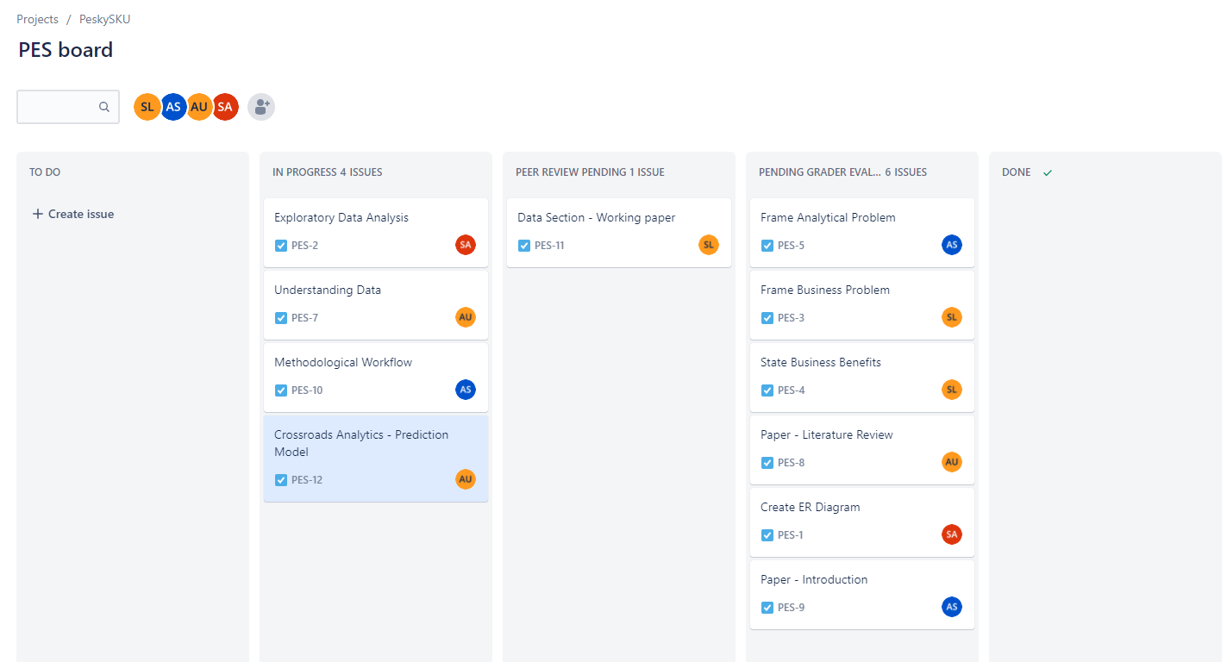
Week 3 - Tasks
Project Tracker: https://peskysku.atlassian.net/jira/software/projects/PES/boards/1

Slide 41
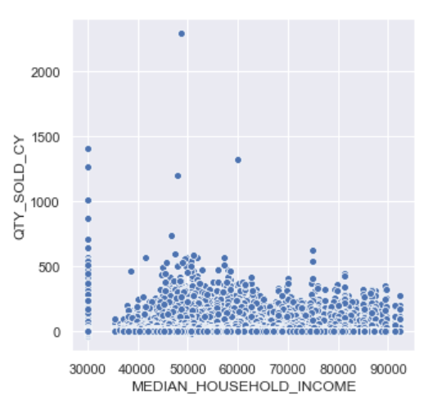
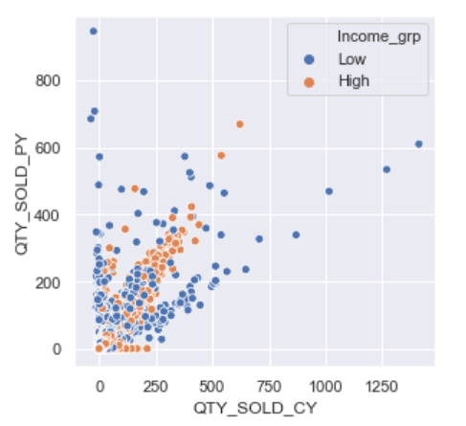
Factors Impacting Sales (Batteries)
Median Household Income

Slide 42
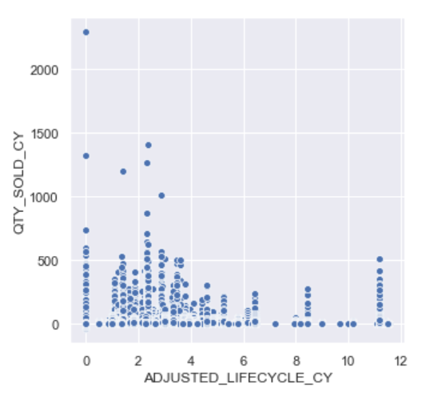
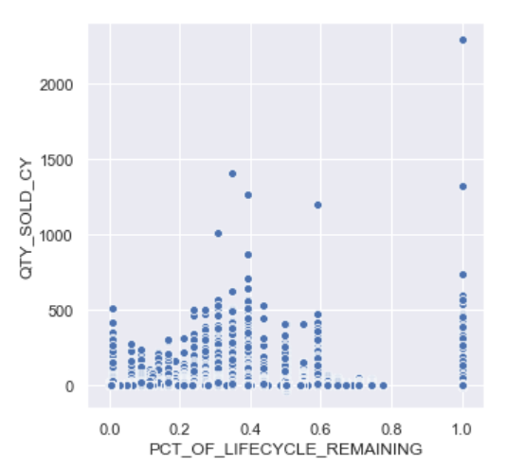
Factors Impacting Sales (Batteries)
Adjusted Lifecycle
% Lifecycle Remaining

Slide 43
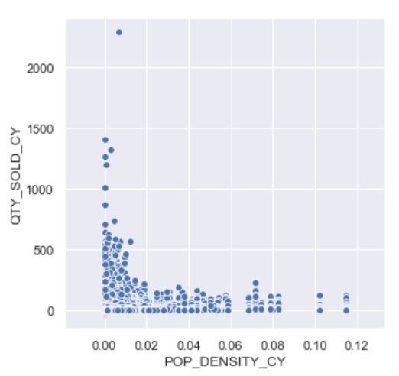
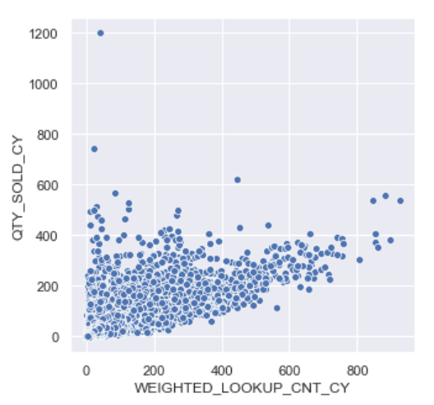
Factors Impacting Sales (Batteries)
Population Density
Lookup Count

